Slide 1
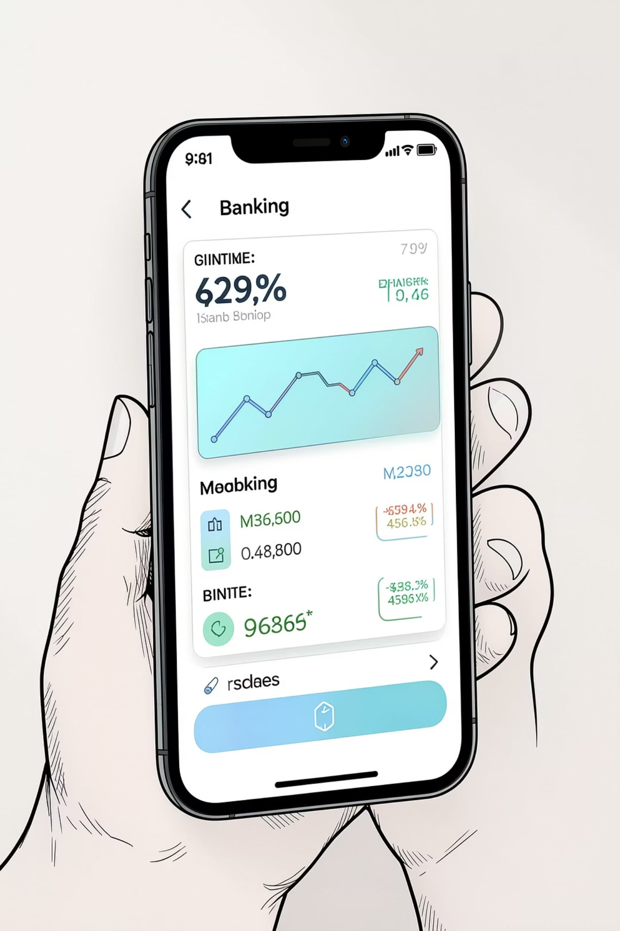
Applying Encapsulation and Abstraction in Online Banking
Presented by:
Pavithra Sri S DEPARTMENT :
REG NO: 192572079 CSE with AI

Slide 2




What an Online Banking System Does
Online banking lets customers manage accounts, transfer funds, check balances, and pay bills through web and mobile channels. It must stay secure, fast, and reliable.
Security
Protects data with encryption and authentication.
Transactions
Supports transfers and bill payments.
Account Services
Shows balances, statements, and history.

Slide 3

Encapsulation — Bundling Data and Behavior
Encapsulation groups related data and methods in classes and limits direct access to internal state. Public methods provide controlled operations, while private members help prevent accidental or unauthorized changes.
BankAccount Class
Benefits
Private data and public methods
Protects data
Prevents unwanted changes
Improves maintainability

Slide 4
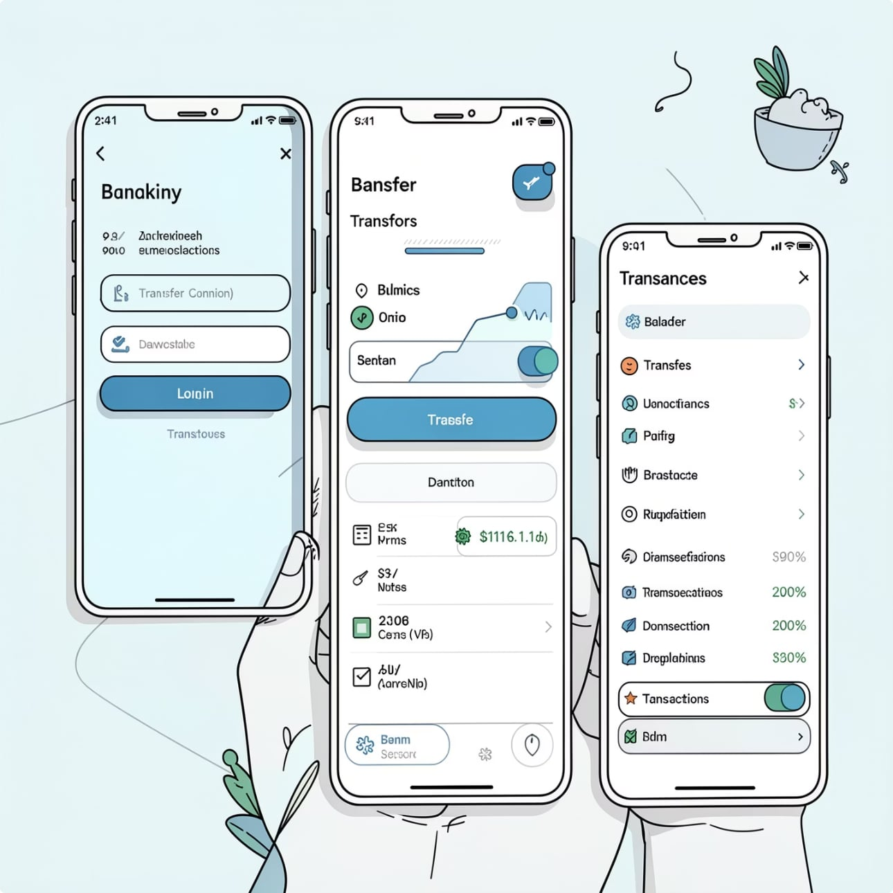
Abstraction — Exposing Essentials, Hiding Complexity
Abstraction gives users a simple interface while hiding the technical work behind it. It shows only the actions people need, while the system handles the implementation details in the background.
Visible to Customer
Login
Check balance
Transfer money
View transactions
Hidden Processes
Database access
Authentication
Encryption
Validation

Slide 5
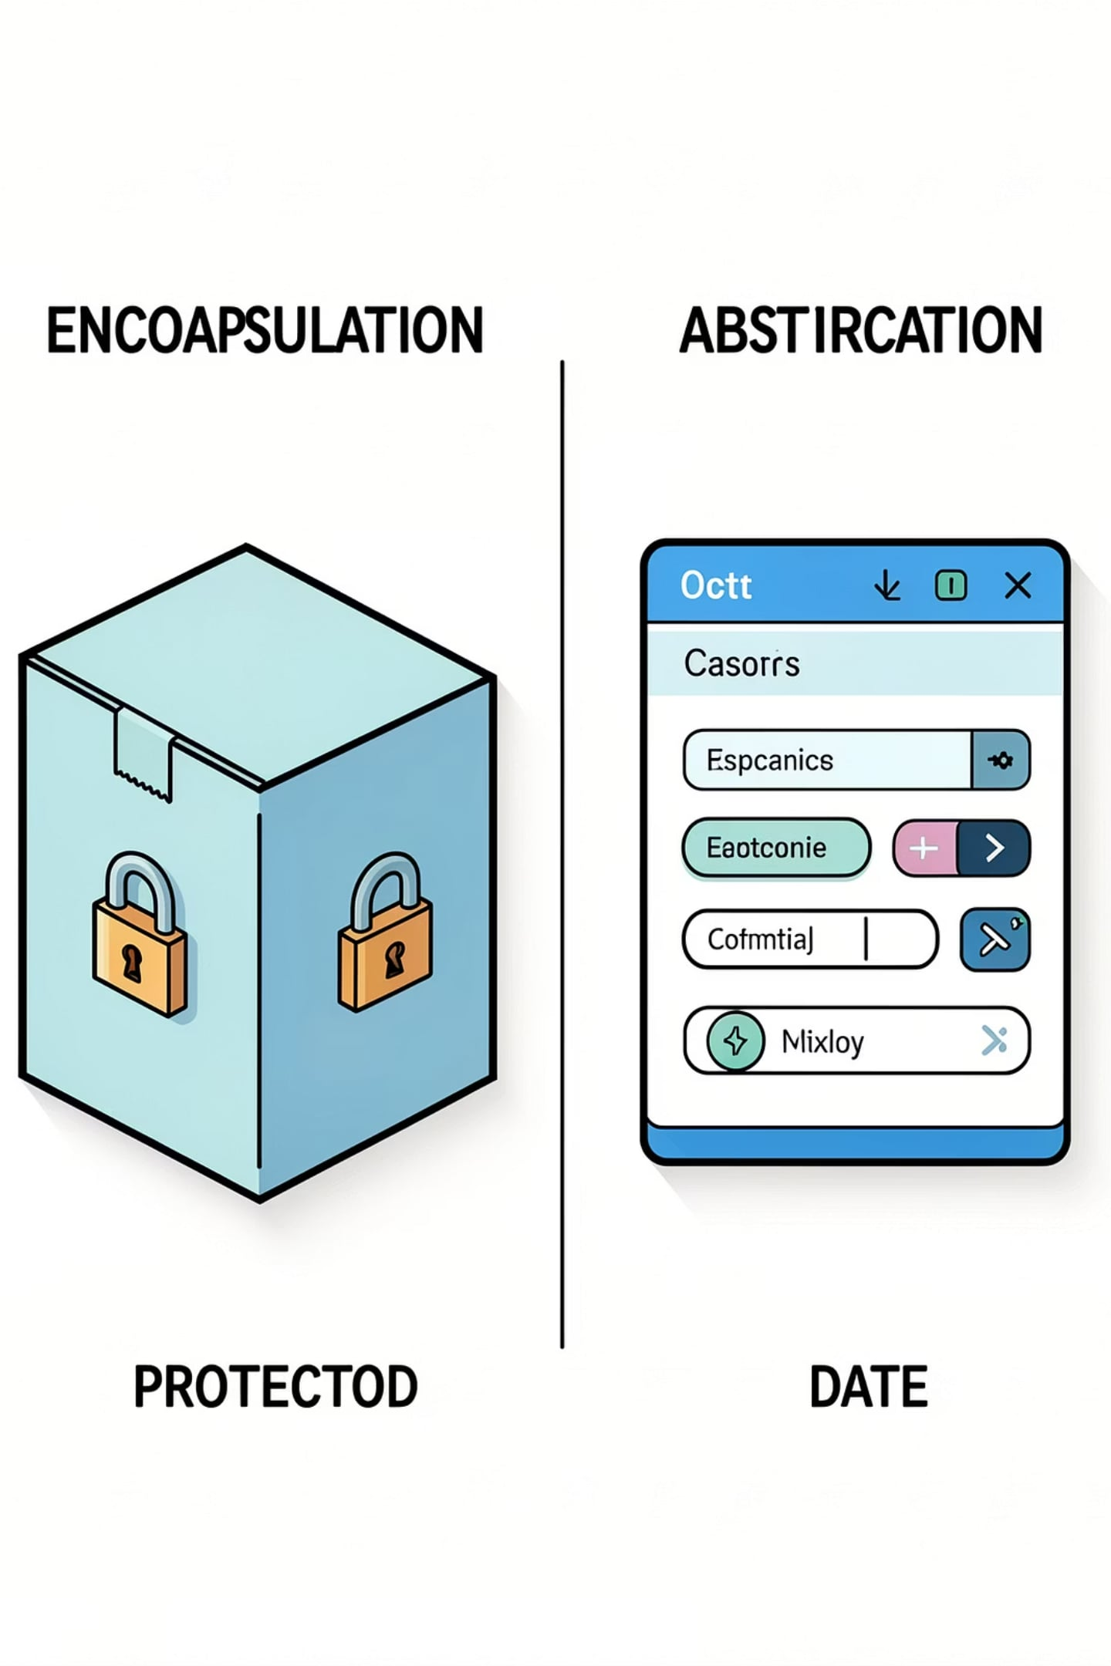
Encapsulation vs Abstraction — Quick Comparison
Encapsulation
Protects data with private members and public accessors.
Abstraction
Hides implementation and shows only essential features.
Typical Constructs
Encapsulation: private fields, getters/setters. Abstraction: interfaces, abstract classes.
Primary Goal
Encapsulation: control access. Abstraction: reduce complexity.

Slide 6

Select Transfer
Validate Funds
Login
Enter Details
Verify
Encapsulation and abstraction keep authentication and validation hidden while the user sees only the high-level steps.

Slide 7


Advantages for Banking Software
Encapsulation
Abstraction
Protects customer data
Prevents invalid changes
Simplifies APIs
Hides complexity
Boosts security, reliability, and maintainability.

Slide 8

Conclusion
Encapsulation secures internal state and controls access. Abstraction simplifies the interface while hiding implementation details. Together, they form essential OOP foundations for secure, maintainable banking systems.
KEY TAKEAWAY:
For developers: define clear class boundaries, use interfaces for external APIs, and keep security-critical logic encapsulated and well-tested.

